Slide 1
2025_Spring_汉字 hànzì (Chinese characters)
1. 月 yuè = moon, month
2. 心 xīn = heart, mind
3. 中 zhōng = central, centre, middle
4. 人 rén = man, person, people
5. 子 zǐ = son
6. 水 shuǐ = water
7. 女 nǚ = female, woman, feminine
8. 几 jǐ = how many, a few, several
* the meaning of 几 jǐ depends on whether it’s in a question or a statement:
Question → "How many?"
Statement → "A few" or "Several"

Slide 2
几 (jǐ) can have different meanings depending on the context:
1. "How many" (question word) – When used in a question, 几 is asking for a small number (typically less than 10).
你几岁？ (nǐ jǐ suì?) → "How old are you?" (for kids under 10) (lesson 5)
现在几点？(xiànzài jǐ diǎn?) → "What time is it now?" (literally: "How many o’clock is it?") (lesson 11)
2. "Several" or "a few" (small quantity) – When used in a statement, 几 can mean "several" or "a few."
我买了几个苹果。(wǒ mǎile jǐ gè píngguǒ.) → "I bought a few apples."
他有几本书。(tā yǒu jǐ běn shū.) → "He has several books."
So, the meaning of 几jǐ depends on whether it’s in a question or a statement:
Question → "How many?"
Statement → "A few" or "Several"

Slide 3
9. 了 le = to finish,particle of completed action
10. 大 dà = big, huge, major, large, vast, great, oldest
11. 我 wǒ = I, me
12. 书 shū = book, lettre
13. 国 (家) guó (jiā) = country, home country
14. 东 dōng = east
15. 西 xī = west
16. 法国 Fǎguó = France
17. 个 gè = general measure word(cl. général)
18. 本 běn = measure word, origin
19. 回 huí = back to, return

Slide 4
20. 上 shàng = up, above, on, top, upon
21. 下 xià = down, below, under
Example:
❶上 上 下 下
shàng shàng xià xià = up and down (upward and downward movements or changes).
❷不 上 不 下
bú shàng bú xià = Neither up nor down = So so
❸不 大 不 小
bú dà bù xiǎo = not big not small (just right!)
❹不 三 不 四
bù sān bù sì = often used to describe people with bad behavior or things that are neither good nor acceptable.
[In French] : louch, bizarre / douteux
不 三 不 四: désigne quelque chose ou quelqu'un de douteux, pas respectable, ni vraiment bon ni totalement mauvais. Cela peut qualifier une personne louche, une situation suspecte ou quelque chose de mal fait."

Slide 5
Classificateur / measure words
1. 个 gè = general measure word(cl. général)
2. 口 kǒu = for family members (cl. membres de famille)
3. 本 běn = for book (cl. Pour livre)
4. 杯 bēi = for cups(cl. pour verres)
5. 块 kuài = money (cl. de l’unite monétaire)

Slide 6
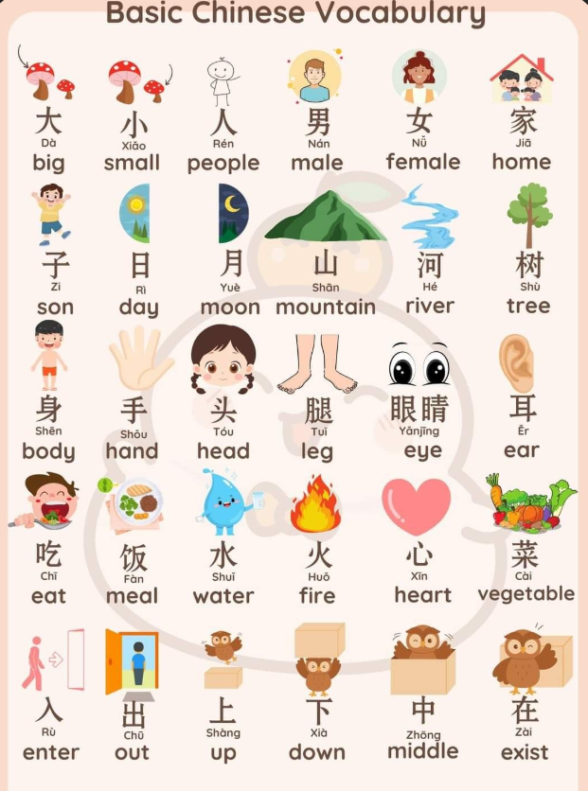

Slide 7
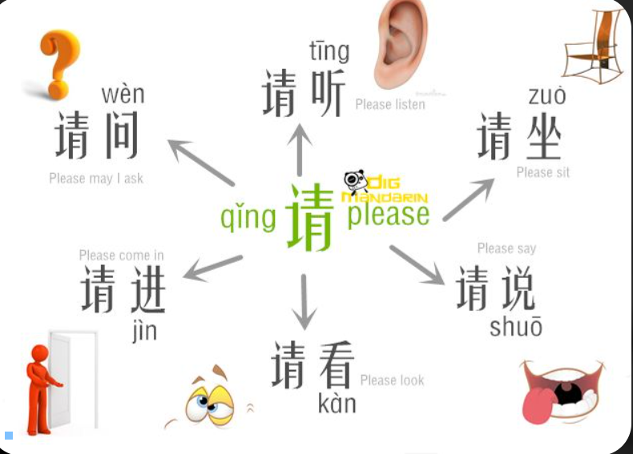
请qǐng = please/ invite = (s'il te plaît)

Slide 8
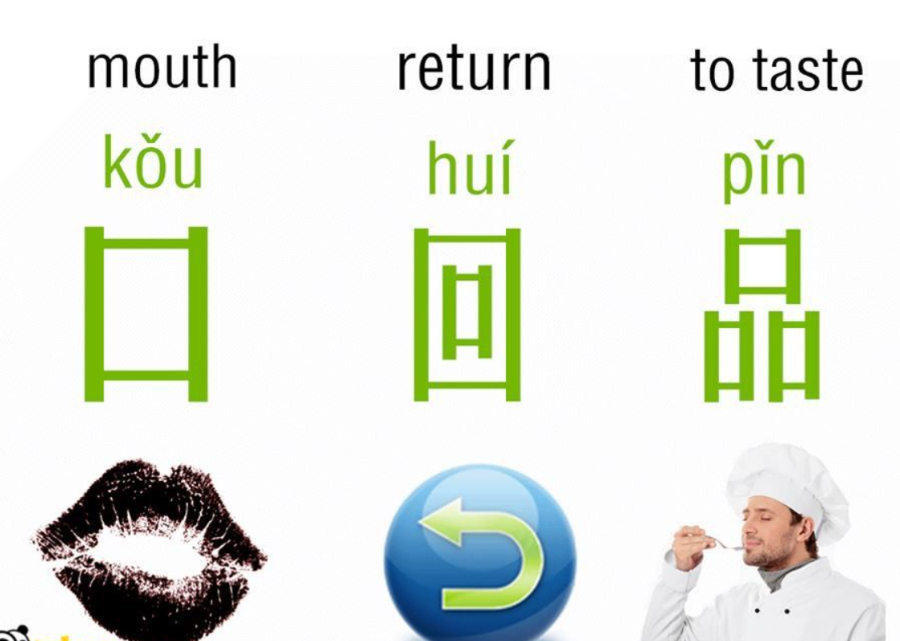

Slide 9
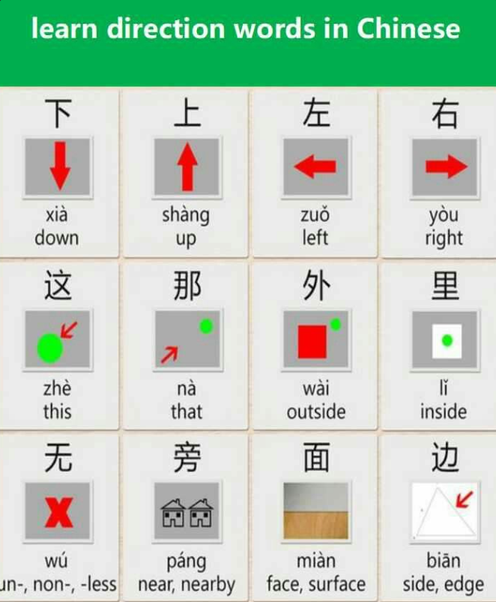

Slide 10
